Slide 1
Chapter 4
DNA
By: Melisa Yeseren, Emily Hamilton and Jeni Tea
Period 1

Slide 2
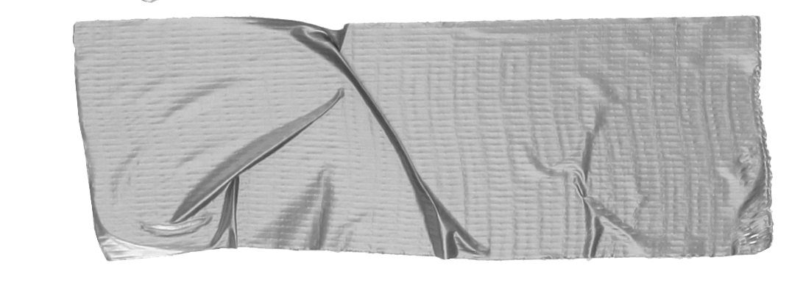
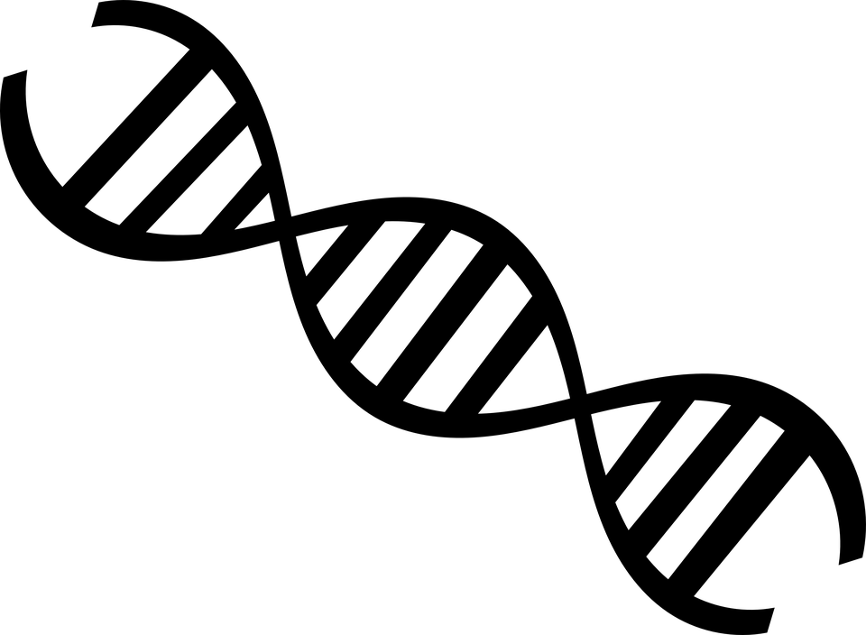
DNA: The Genetic Fingerprint
DNA Technology: science of identifying the genetic blueprint of any organism in every cell
One of the most effective methods in law enforcement
DNA can tell 2 people apart
DNA can aid the criminal justice system in positive determinations or criminal identity

Slide 3
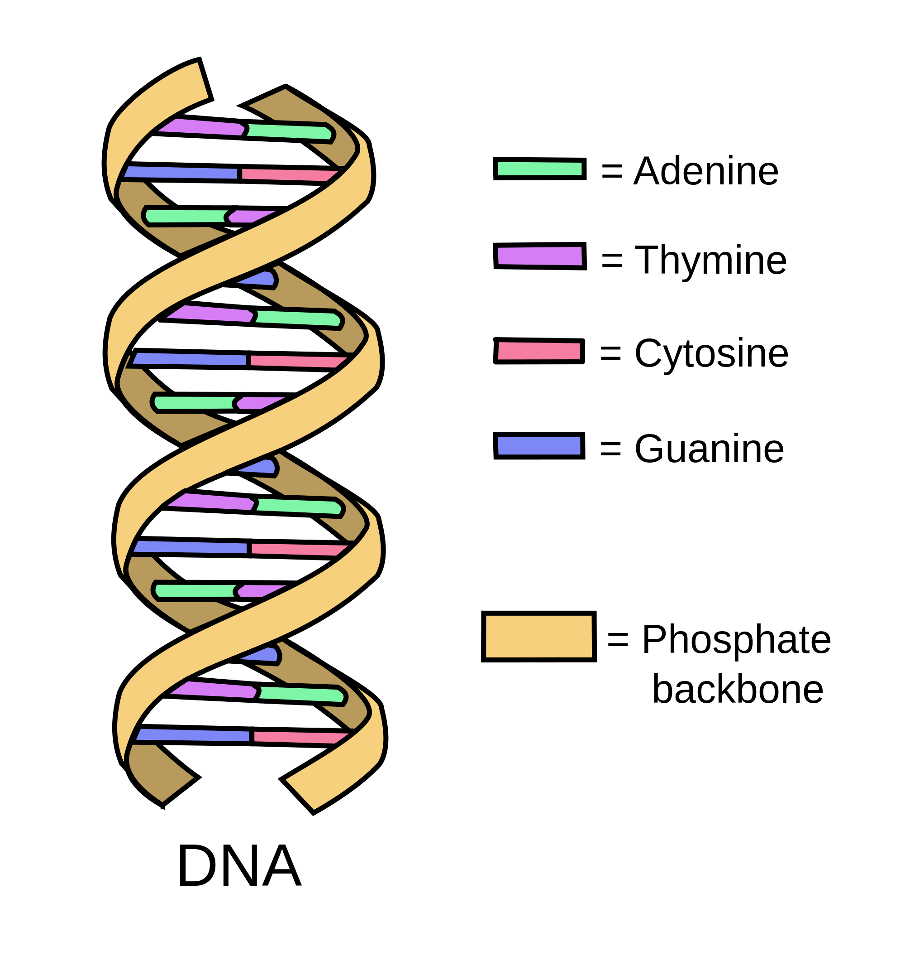
What Is DNA?
DNA - deoxyribonucleic acid; hereditary material is humans and organisms
Info in DNA stored in a code made by 4 bases: adenine (A), thymine (T), cytosine (C ), and Guanine (G)
DNA is made up on 5 different components: carbon, hydrogen, oxygen, nitrogen, and phosphorus
No 2 persons are alike (except twins)
Tip
Don’t wait till the end of the presentation to give the bottom line.
Reveal your product or idea (in this case a translation app) up front.

Slide 4
The History of DNA
DNA fingerprinting revolutionized forensic science
DNA sequences are repeated over and over
Dr. Jeffrey created human identity tests
DNA repeat regions are known as variable number of tandem repeats (VNTRs)

Slide 5
Analyzing DNA
Patterns found in blood or semen are just as distinctive as fingerprints
Investigators and laboratory personnel work together to figure out which pieces are the most important
Every officer should be aware of issues with identification, collection, transportation and storage of DNA evidence
DNA evidence can carry diseases like HIV
Biohazardous material must go in a seperate container labeled so
DNA analysis

Slide 6
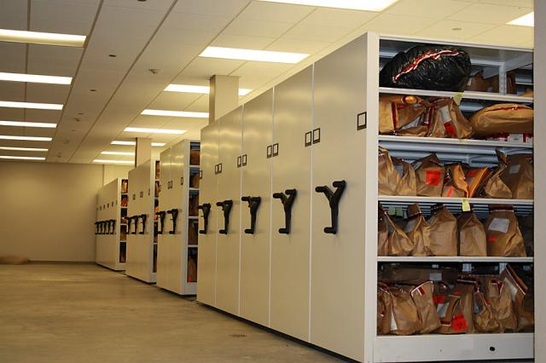
Transportation and Storage
How to handle the evidence:
Step 1: Keep dry at room temperature
Step 2: Secure in paper bag or envelope
Step 3: Seal, label, transport with proper identification
NEVER: Put evidence in a plastic bag because it retains damaging moisture.
NEVER: Put DNA evidence into direct sunlight or evidence in general in a hot room

Slide 7
Elimination Samples
Used to determine whether the evidence comes from the suspect or someone else
Rape cases are an example in which elimination samples are extremely useful.
-They eliminate the DNA of consensual partners and set them aside from the rapist

Slide 8
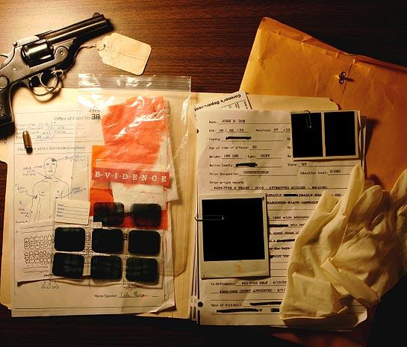
Admissibility of DNA as Evidence
The admissibility of scientific evidence is determined through…
-The relevancy test and the frye test.
The relevance test permits the admission of relevant evidence. The frye test involves the use of scientific evidence.
Two step analysis of frye test:
1:Identifying the field in which the underlying theory lies
2:Determining whether the principle has been accepted by most members of the field identified.

Slide 9
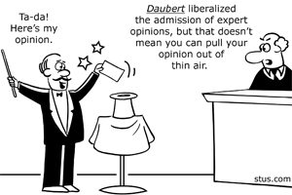
The Daubert Standard
Trial judges must evaluate proffered expert witnesses to determine whether their testimony is both relevant and reliable. Two prongs of test admissiblity are used:
1:The relevancy prong-Whether or not the evidence fits the case.
2:The reliability prong:Evidence and conclusions must be derived from the scientific method.

Slide 10
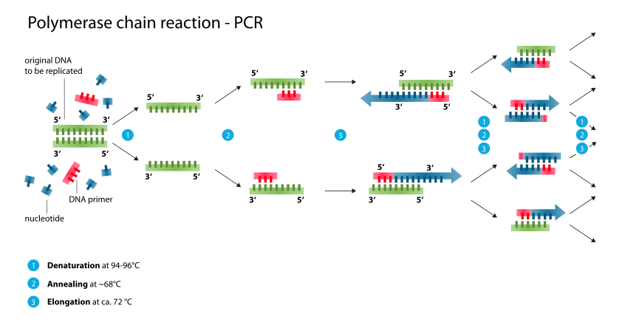
Other uses of DNA
PCR:Cells producing billions of DNA strips can be reproduced rapidly in a test tube. Used for:
1:Comparing DNA of extinct animals
2:Assisting the military in identifying remains of soldiers
3:Helping detect small numbers of cancer

Slide 11
Preservation of fingerprints (PG:110)
Preserving fingerprints is important so that they can be used for later examination and in court.
Methods of fingerprint preservation:
-Photographing
-Varying lifting techniques

Slide 12
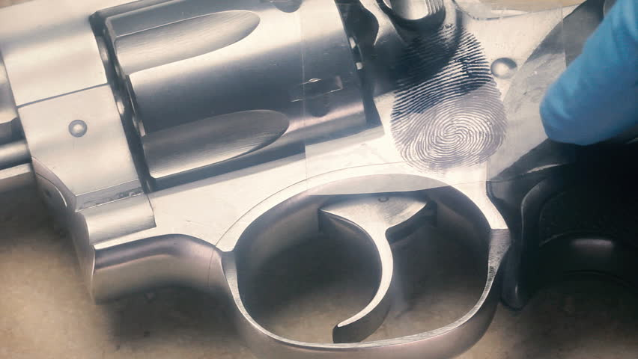
Fingerprint lifters are people who are trained to lift and remove the print from surfaces that are curved or otherwise difficult to photograph

Slide 13
Plastic and latent fingerprints can usually last years depending on the surfaces they are on.
Lifting procedure:
Dust print with print powder
Place tape over print
Remove print
*important lifting tip*: Investigators must avoid air pockets in the tape while being applied because air pockets could ruin the lifted print.

Slide 14
Latent Prints: Impressions produced by the ridges of the skin on human fingers,palm, and soles of the feet.
Plastic fingerprint:A fingerprint impression left when a person presses against a plastic material such as putty, wax, or tar.

Slide 15
Prints from gloves pg:110
Many criminals use gloves as protective measures however if a glove is located then they can contain evidence.
-Glove may have unique, identifiable patterns, as with fingerprints.
Leather gloves: could contain fatty material.
Fabric gloves: often contain soil or other foreign matter.
Both: ridge patterns can be left on both.

Slide 16
Integrated automated fingerprint identification system (IAFIS) pg: 111& 109
https://youtu.be/ZKi1CKTRCQM

Slide 17
https://www.bing.com/images/search?view=detailV2&ccid=%2bKE6Y0nn&id=3F9930D9DBB5058BCADD4D6D6BDE3EFEEB33CB64&thid=OIP.-KE6Y0nn0vis81KEhcRy1AEsD_&q=evidence+admissibility&simid=608027002856342297&selectedIndex=8&ajaxhist=0
Sources
https://ghr.nlm.nih.gov/primer/basics/dna
http://www.biologyreference.com/Fo-Gr/Forensic-DNA-Analysis.html
https://youtu.be/JUoBTk1NDZ8
http://2014.igem.org/Team:UCC_Ireland/Projects_SeeDNA.html
https://pattersonpope.com/2014/09/05/evidence-storage-changes/

