Slide 1
Performing a Follow-up Investigation
By: Karla Cortes & Alberto De leon III

Slide 2
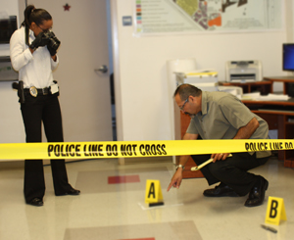
Follow-up Investigation
A continuing phase of the investigation in which information that is learned in the preliminary investigation is added to or built on.

Slide 3
Follow up investigation more In depth…

Slide 4
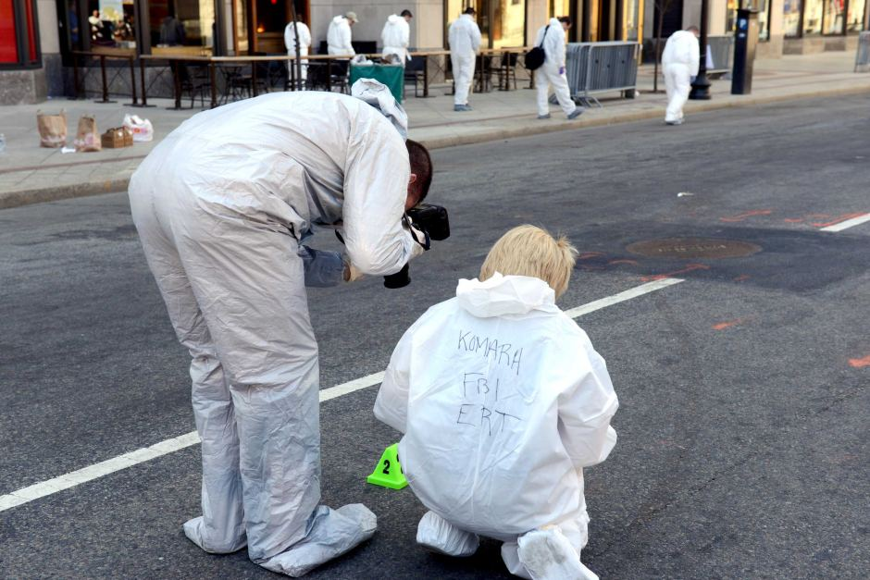
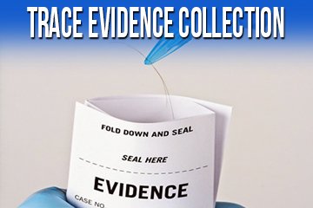
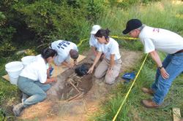
Case In point 1 – General Rules of Crime scene Searching
Crime scene investigators should always wear protective clothing to preserve evidence from contamination and to safeguard themselves.
All major items are examined, photographed ,recorded, and collected, as appropriate , taking them in the order that is most logical, considering the requirement to conserve movement.

Slide 5
Case in point 1 - Continuation
After the search, the body should be removed and the processing of obvious evidence should begin.
Trace evidence should be searched for and collected before dusting for fingerprints.
When sweeping or vacuuming, surface areas should be segmented , the sweepings from each area packaged separately , and the locations of their point of recovery noted.
Last but not least normally elimination fingerprints and physical evidence standards are collected after the preceding actions have been completed.

Slide 6
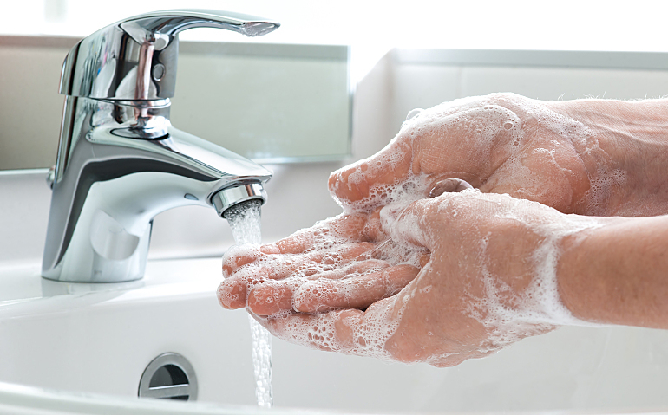
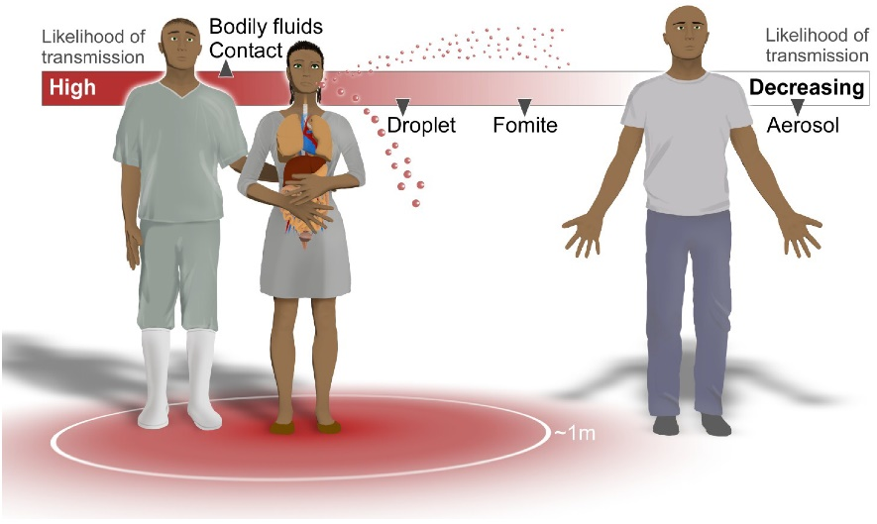
Case in Point 2- Recommendations for Dealing with infected Evidence
Human Bites- Viral transmission through saliva is unlikely ; however if bitten, after milking the wound , rinse well and seek medical attention.
Saliva, urine and feces- Viral transmission through saliva is unlikely. In urine , the virus is isolated in very low amounts and it’s nonexistent in feces.
Cuts and puncture wounds- When searching areas hidden from view , use extreme caution to avoid sharp objects.

Slide 7
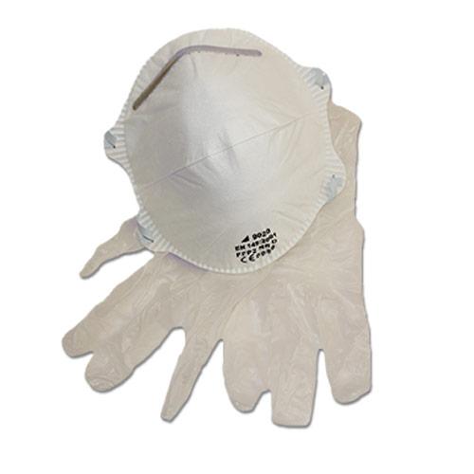
Case in point 2 continuation
Cardiopulmonary resuscitation (CPR) and first aid. Minimal risk is associated with CPR, but it is a good idea to use masks or airways and gloves when in contact with bleeding wounds.
Body removal- As with all crime scenes, when in contact with a dead body, always wear protective gloves

Slide 8
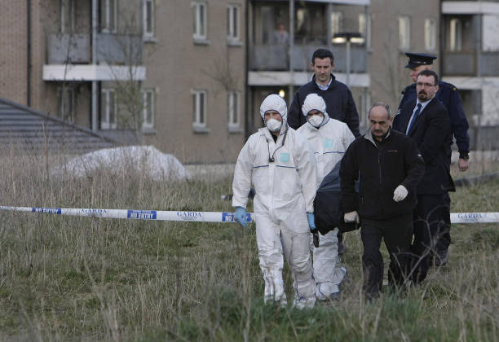
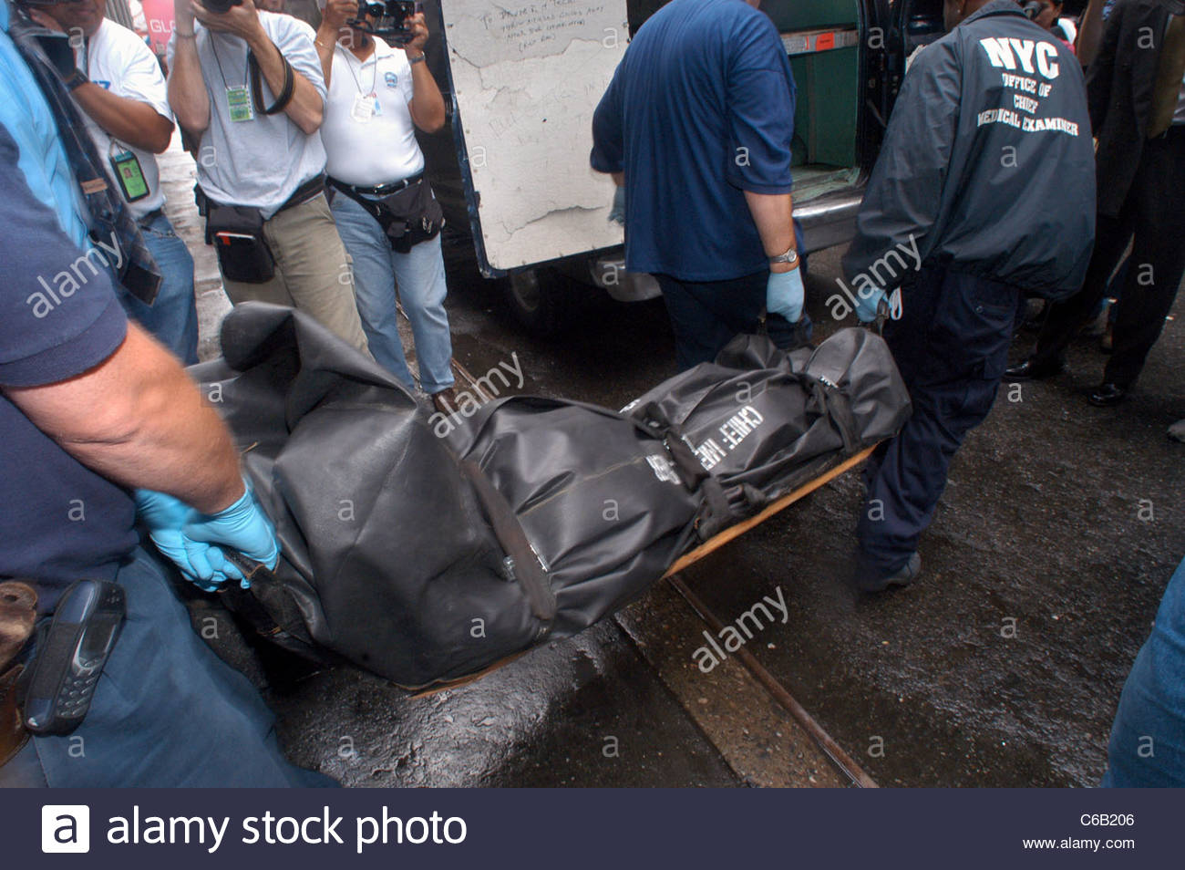
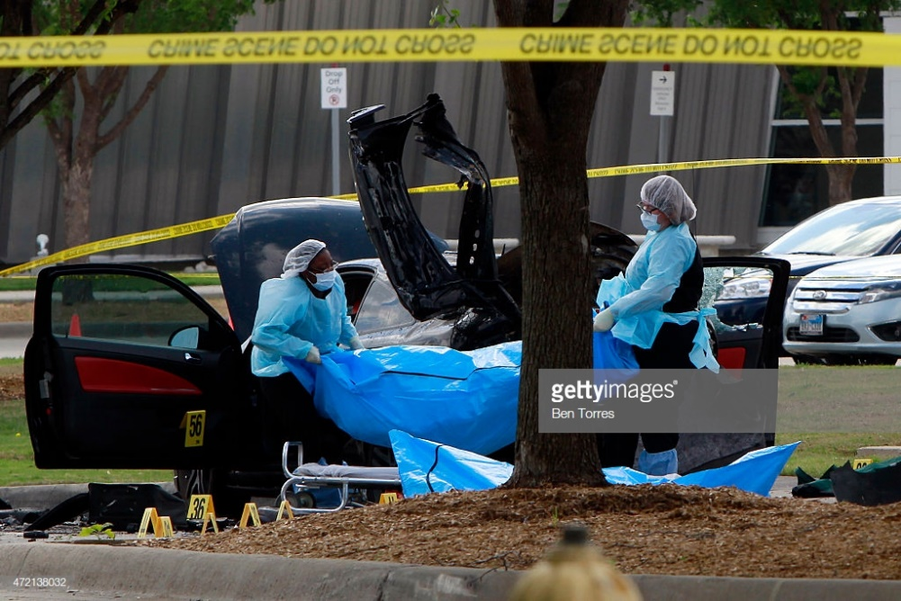
These are some pictures of body removal showing exactly what they have to use in which it ranges from hazmat suites , face masks, to gloves.

Slide 9
Cold Justice episode (43:00 Minutes)
https://youtu.be/C64bbGTf9Oc

Slide 10
References…
Google Search, Google, www.google.com/search?q=follow-up investigation&safe=strict&rlz=1C1IPOA_enUS704US818&source=lnms&tbm=isch&sa=X&ved=0ahUKEwjcnOnJs_fdAhXFylMKHcueDawQ_AUIDygC&biw=1280&bih=928#imgrc=Um3jUj7XUI7eZM:
“Criminal Investigations Section.” NMSU Police Department, www.nmsupolice.com/criminal-investigations-section/.

