Slide 1

Bulldog Outfitters
Mrs. Steele’s 4th Period Economics

Slide 2

Branding
Slogan: Bold looks for bold bulldogs! Shop Bulldog Outfitters!
Advertising: Instagram, Facebook, Tik Tok.

Slide 3
Statistics On Students Likes
Item 1: 68.4 %
Item 2: 75%
Item 3: 70%
Item 4: 54%
Item 5: 76%
Item 6: 51.4%
We started as a class voting on items we all created and choose the best ones to present to students.
AP students from different classes took a survey that analyzed what products have the most interest.
The most wanted items were selected to include in our first launch.

Slide 4
Marketing Appeals
Teachers and Staff will have the opportunity to buy merchandise at a discounted price.
Military Discounts for veterans and their families.
BOGO’s/ discounts for buying multiple items.

Slide 5
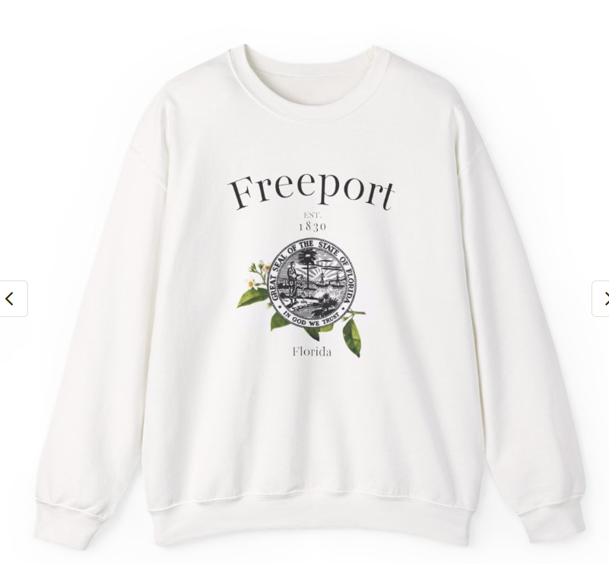
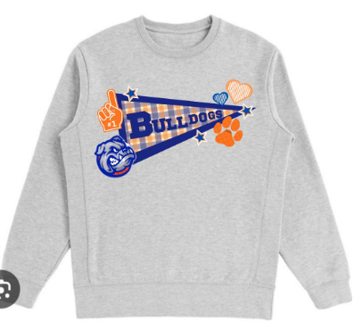
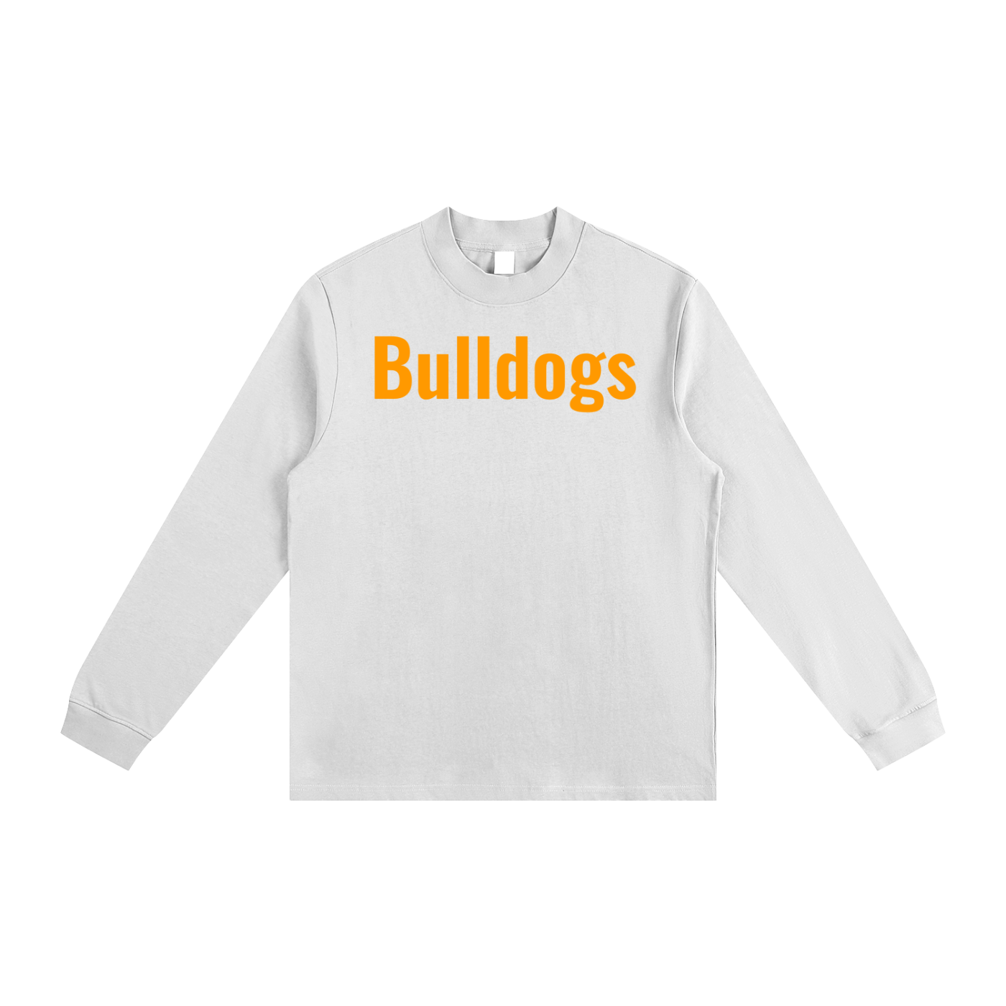
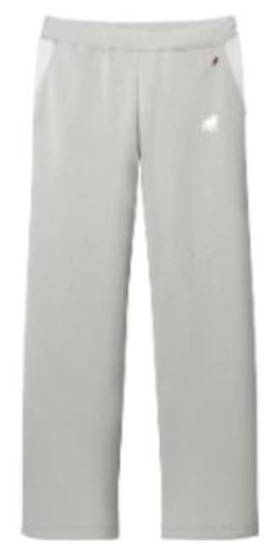
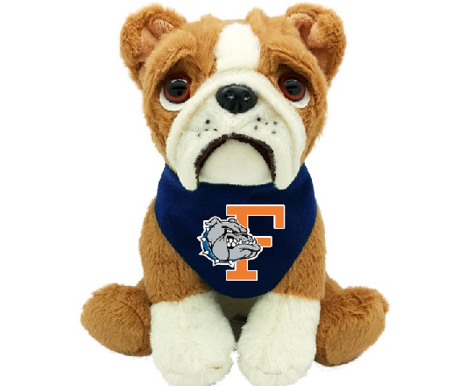
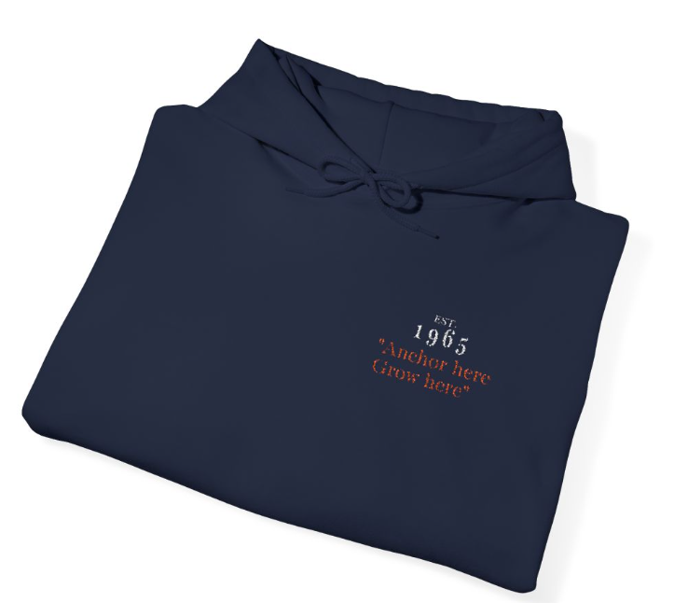

Slide 6
Merchandising & Inventory
Supply:
Suppliers: Tapstitch (tapstitch.com)
Printify
(https://printify.com)
(schoolspiritproducts.com)
Online store: Shopify (shopify.com)

Slide 7
City of Freeport Sweatshirt
Units ordered: 50
Cost per Unit: $17.97
Selling price: $35.00
Total cost: $898.50
Total revenue: $1750.00
Total profit: $851.50

Slide 8
Unisex Bulldog Hoodie
Units Ordered: 50
Cost Per Unit: $22.92
Selling Price : $40.00
Total Cost: $1146
Total Revenue:$2000
Total Profit:$854

Slide 9
Blitz Plush
Units ordered: 25
Cost per Unit: $13.00
Selling price: $20.00
Total cost: $325.00
Total revenue: $500.00
Total profit: $175.00

Slide 10
Female Bulldog Sweatshirt
Units ordered: 50
Cost per Unit: $14.40
Selling price $35.00
Total cost: $869.50
Total revenue: $1750
Total profit: $880.50

Slide 11
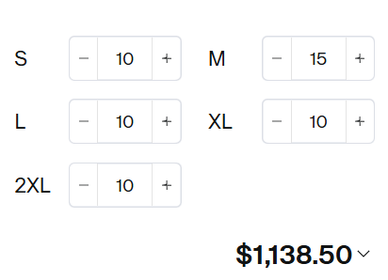
Unisex Bulldog Print Sweatpants
Units ordered: 55
Cost per Unit: $20.70
Selling price $40.00
Total cost: $1138.50
Total revenue: $2200.00
Total profit: $1061.50

Slide 12
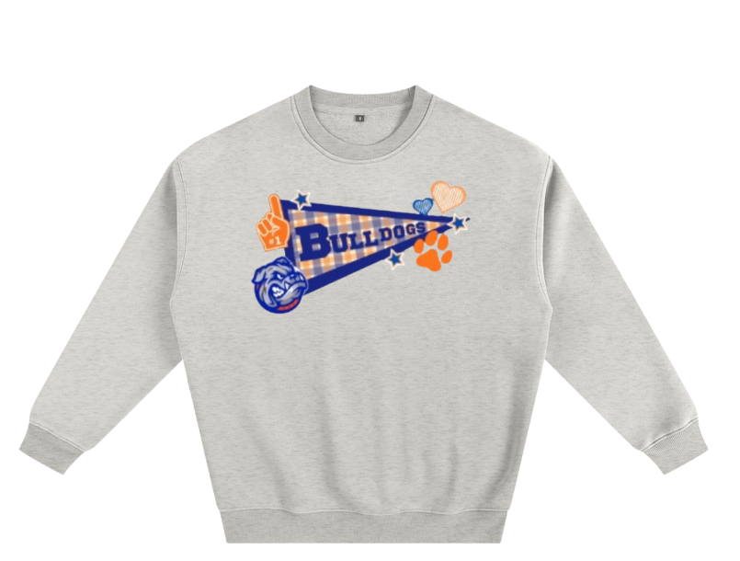
Female College “Stitched” Crewneck
Units ordered: 50
Cost per Unit: $14.92
Selling price: $45.00
Total cost: $895.50
Total revenue: $2,250.00
Total profit: $1,354.50

Slide 13

Total Profits
Total cost $5,272.50
Total revenue $8,200
Total profit $2927.5

Slide 14
Will you
Own it?

